Slide 1
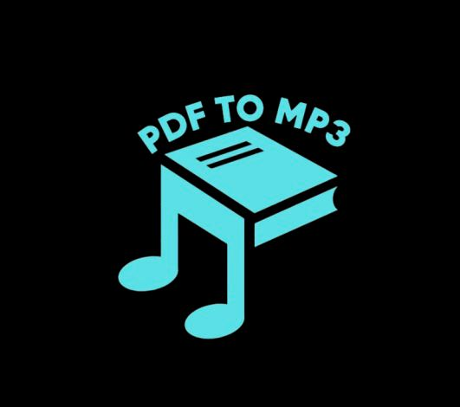
PDF TO MP3 APP
AGATHIYAN V(192221126)
DEPT - IT

Slide 2
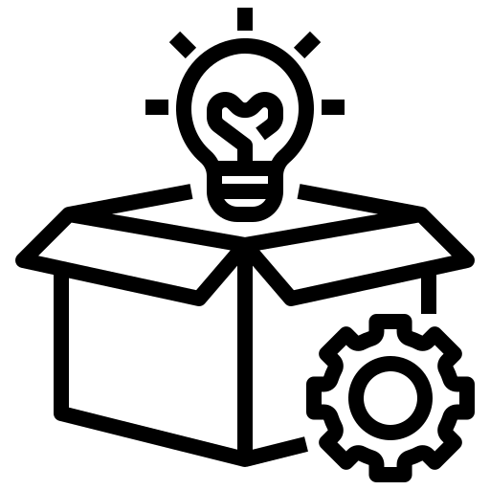
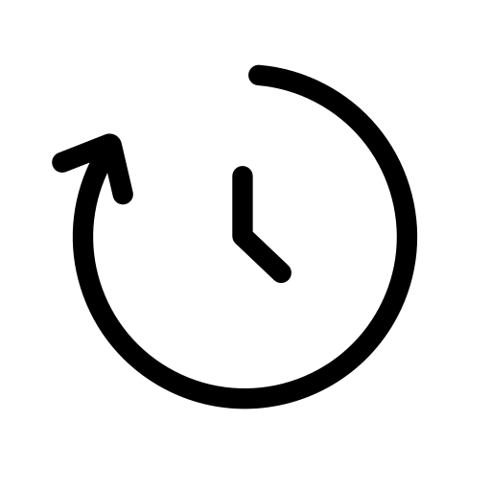
PROJECT OVERVIEW
PROJECT:
A simple and secure app to convert PDFs into MP3 audio files. Just upload your document, and the app will read it aloud to you in clear, natural-sounding speech. Perfect for those on the go, or for anyone who prefers audio over reading.
PRODUCT DURATION:
10th Dec 2024 To 14th Jan 2025

Slide 3


PROJECT OVERVIEW
Problem
Many people with visual impairments or learning disabilities struggle with PDFs due to complex features like images, tables, and varied fonts. Traditional text-to-speech software may not interpret these elements correctly. Manually converting PDFs to audio is time-consuming and requires specialized software.
Solution
Create an application that allows users to easily convert PDFs into high-quality MP3 files, making the information accessible to a wider audience.

Slide 4

Article: Transforming Document Access with PDF to MP3 Technology
Reading lengthy PDFs can be a challenge, especially for those with visual impairments or busy schedules. The PDF to MP3 App addresses these issues by converting PDF documents into high-quality MP3 audio files, enabling users to listen to content hands-free. With features like customizable reading speeds, multi-language support, and offline access, it offers an efficient, accessible, and flexible solution for students, professionals, and anyone on the go.
The app is user-friendly, scalable, and designed with the future in mind, with potential features like voice recognition and AI-powered summarization. Whether you're reading textbooks, reports, or eBooks, the PDF to MP3 App simplifies document consumption, making it easier to process and engage with content at your own pace. Embrace a smarter, more accessible way to interact with your documents today!
Agathiyan

Slide 5
PROBLEM STATEMENT
Priya is a visually impaired student who faces challenges accessing reading materials in a traditional text format.
She needs an app that can easily convert PDFs into MP3 files, providing her with clear audio output to help her study independently and keep up with her coursework.
As a busy student and professional, She prefers solutions that allow her to multitask without compromising productivity , making it easier to listen to important documents anytime, anywhere.

Slide 6

PROJECT OVERVIEW
My Responsibilities
We are responsible for Design, code, and maintain the app.Ensure the app's functionality and security
We will also Test, debug, and optimize the app. Collaborate with the team to meet project goals
My Role
I’ll designed figma designs and wireframing, & created and develop frontend of PDF TO MP3 app ,develop Backend of PDF to MP3 app. Focus on security, usability, and functionality.
We are Implement new features, fix bugs, and ensure the app runs efficiently for users.

Slide 7
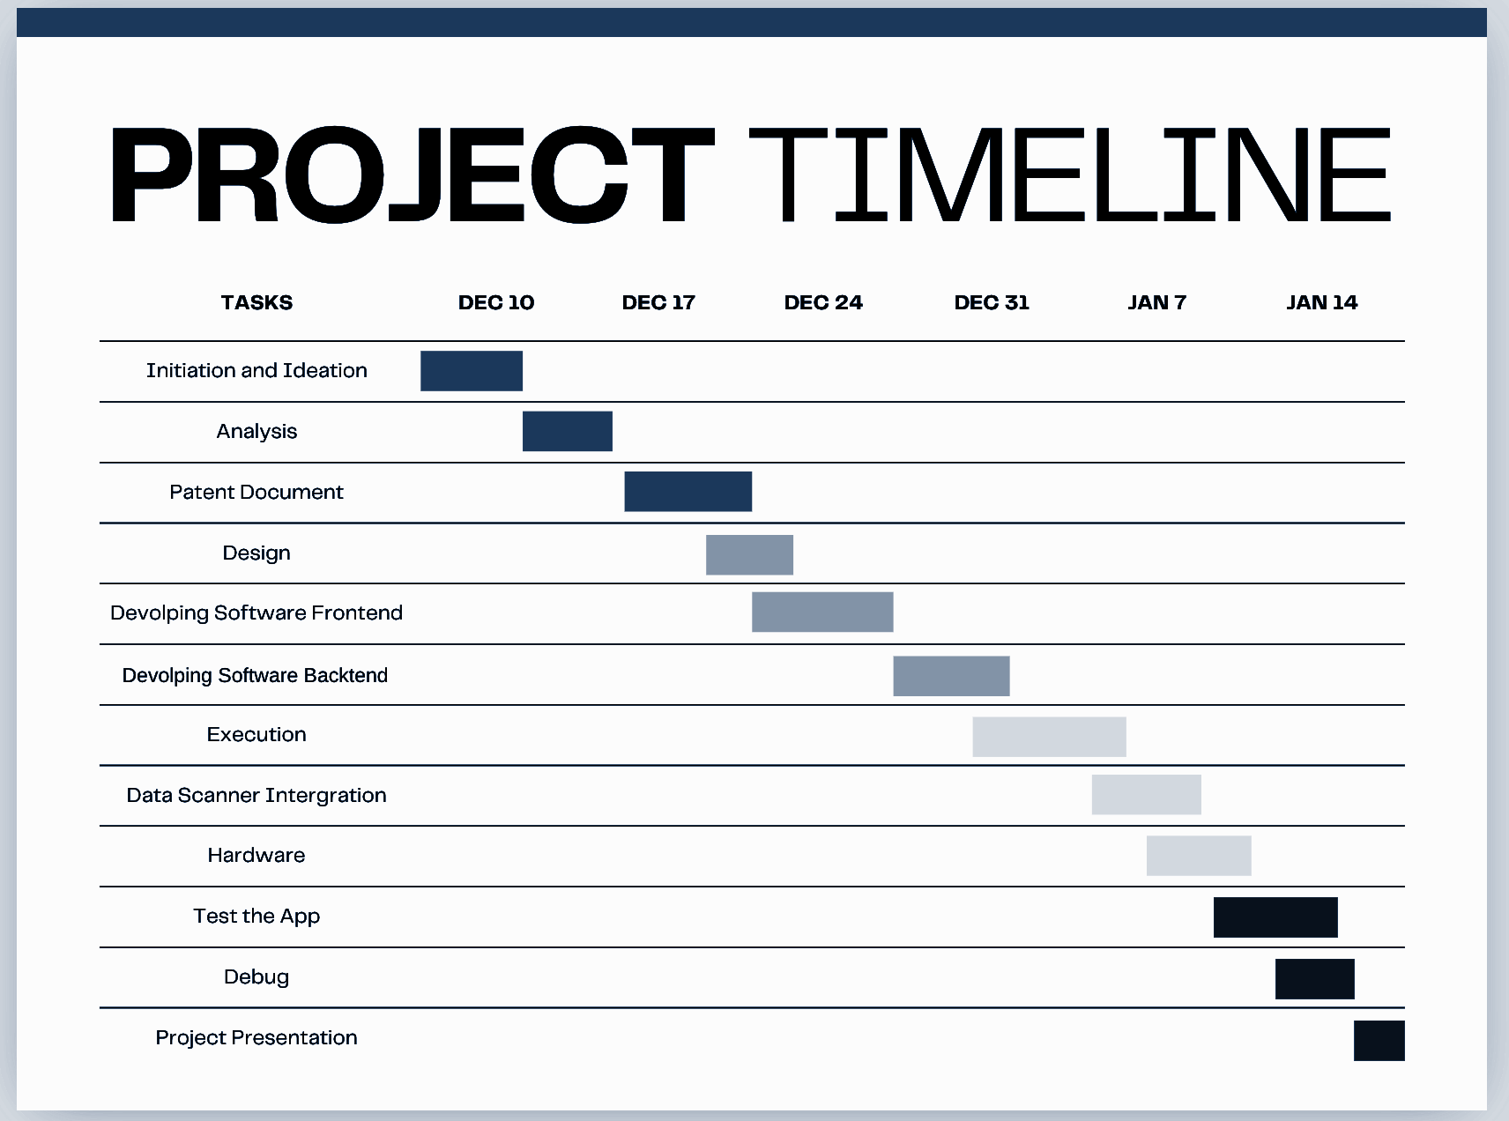
Project Task Allocation

Slide 8
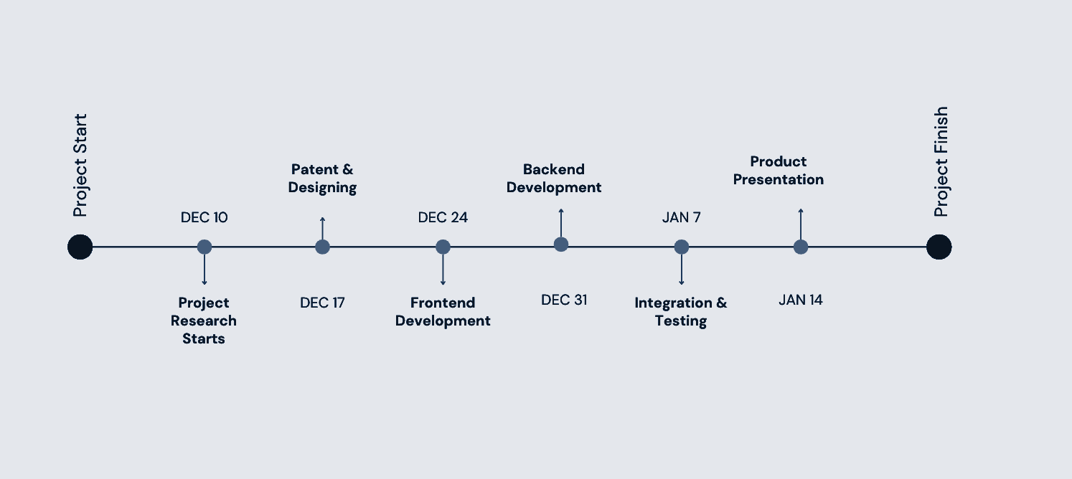
PROJECT TIMELINE

Slide 9

Persona: Ravi
Goals:
Convert PDF documents into high-quality MP3 files for on-the-go learning.
Simplify the process with minimal steps and an intuitive interface.
Access different voices or languages for better understanding.
Save and manage converted files efficiently for future use.
Problem Statement
Ravi is a college student who struggles to keep up with his reading assignments due to a busy schedule. He needs an app that can convert PDFs into audio files, enabling him to listen to study materials while commuting or multitasking. The app should be simple, fast, and provide clear audio output to enhance accessibility and convenience.
Frustrations:
Finds it hard to allocate dedicated time for reading long PDFs.
Struggles with maintaining focus when reading for extended periods.
Lacks access to a reliable tool for seamless text-to-audio conversion.
Frustrated with apps that are complicated or have low-quality audio output.
Name: Ravi
Age: 20
Profession: College student
Location: Delhi, India
"Hi, I'm Ravi, a 20-year-old college student. I'm always on the go and looking for tools to make studying more efficient and flexible."

Slide 10

Persona: Priya
Frustrations:
Finds it difficult to navigate PDFs and other text-based materials without assistance.
Struggles to find accessible apps that cater specifically to visually impaired users.
Frustrated with apps that have complex interfaces or lack proper accessibility support.
Experiences delays in completing assignments due to dependency on others for reading content.
Problem Statement
Priya is a visually impaired student who faces challenges accessing reading materials in a traditional text format. She needs an app that can easily convert PDFs into MP3 files, providing her with clear audio output to help her study independently and keep up with her coursework. The app should be designed with accessibility in mind, offering features like voice guidance and screen reader compatibility.
Goals:
Convert PDF documents into high-quality MP3 files for on-the-go learning.
Simplify the process with minimal steps and an intuitive interface.
Access different voices or languages for better understanding.
Save and manage converted files efficiently for future use.
Name: Priya
Age: 28
Profession: Student
Location:Mumbai, India
"Hi, I’m Priya, a 22-year-old student. I rely on technology to access information and study effectively. I value tools that make learning easy and inclusive for everyone."

Slide 11
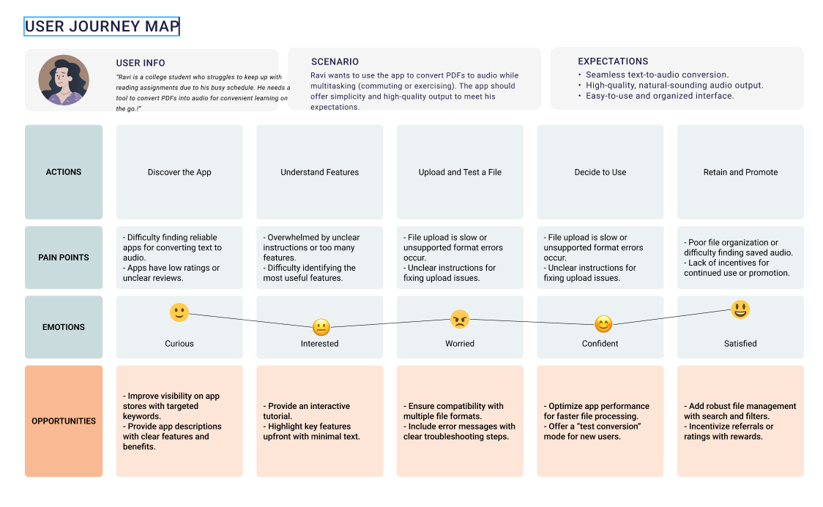
User Journey Map

Slide 12
Competitive Analysis
Feature/Aspect | Our PDF-to-MP3 Project | Speechify (Direct) | Audible (Direct) | LibriVox (Indirect)
Core Offering | Seamless PDF-to-MP3 conversion tailored for users who want to listen to their documents | AI-powered text-to-speech conversion, general text support | Audiobook subscription with curated audiobook content | Free volunteer-driven audiobooks from public domain
Target Audience | Professionals, students, and readers who need audio versions of their PDFs | Students, professionals, and individuals with dyslexia | Audiobook listeners globally | Readers of public domain books
Pricing | Competitive pricing, potentially with a free basic version and premium advanced features | ₹999/month | ₹199/month | Free
Unique Value Proposition | Highly accurate PDF parsing; voice customization; optimized for documents with complex layouts | High-quality, customizable audio output with adjustable voices and accents | Access to an extensive library of exclusive audiobooks | Free access to public domain content
Document Compatibility | Designed specifically to handle PDFs, including tables, headers, and complex formatting | Supports general text formats but not optimized for PDFs | No support for PDFs or document conversion | No support for PDFs
App or Mobile Experience | User-friendly mobile app with PDF upload, MP3 download, and offline access | Fully functional app with text syncing and speed controls | Feature-rich app for audiobooks | Basic functionality with minimal playback options

Slide 13
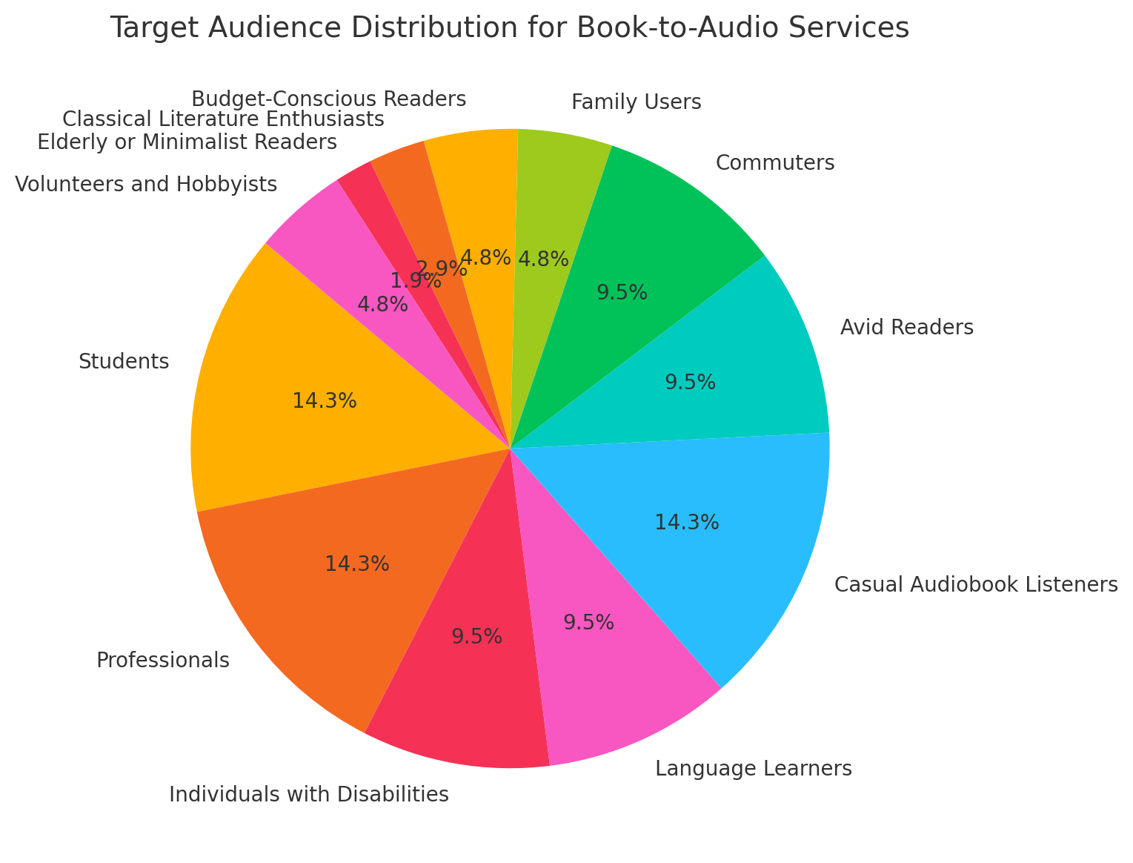
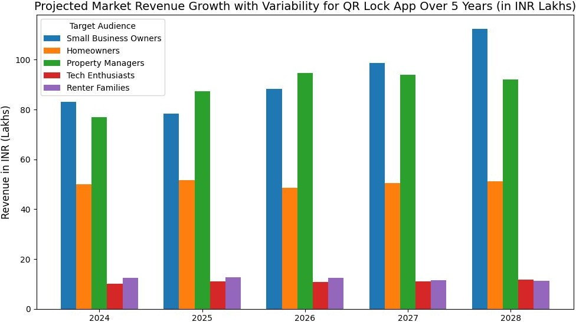
Business Potential
Market revenue
Target Audience

Slide 14
GAP ANALYSIS
Technology: Expand features to include summarization and AI-generated natural voices.
Security: Add encrypted file handling and two-factor authentication.
User Experience: Offer customizable voices, accents, and playback speeds.
Market Reach: Target educators, Visually impaired persons, researchers, and accessibility communities.
Pricing: Provide flexible plans, including pay-per-use and student discounts.
Compatibility: Integrate with cloud storage and multiple file formats.
Brand Identity: Partner with accessibility groups and showcase user success stories.
Customer Support: Provide 24/7 support with voice-based assistance and tutorials.

Slide 15
User Pain Points
01
Difficulty in Conversion Process
02
Lack of Customization Options
03
Privacy and Security Concerns
Slow Conversion Times: Many apps take a long time to convert PDF files to MP3, especially large files.Limited File Formats: Not all apps support all PDF file formats, leading to compatibility issues.Low Audio Quality: The audio quality of converted files can be poor, making them difficult to listen to.Complex User Interface: Some apps have a complicated user interface that is difficult to navigate.
Data Security Risks: Users may be hesitant to upload their PDF files to an app due to privacy and security concerns.Lack of Encryption: Some apps don't encrypt user data, making it vulnerable to security breaches.Unclear Data Usage Policies: It's essential for users to understand how their data is used by the app.Limited File Size Limits: Small file size limits can be a significant issue for large PDF files.
Slow Conversion Times: Many apps take a long time to convert PDF files to MP3, especially large files.Limited File Formats: Not all apps support all PDF file formats, leading to compatibility issues.Low Audio Quality: The audio quality of converted files can be poor, making them difficult to listen to.Complex User Interface: Some apps have a complicated user interface that is difficult to navigate.

Slide 16
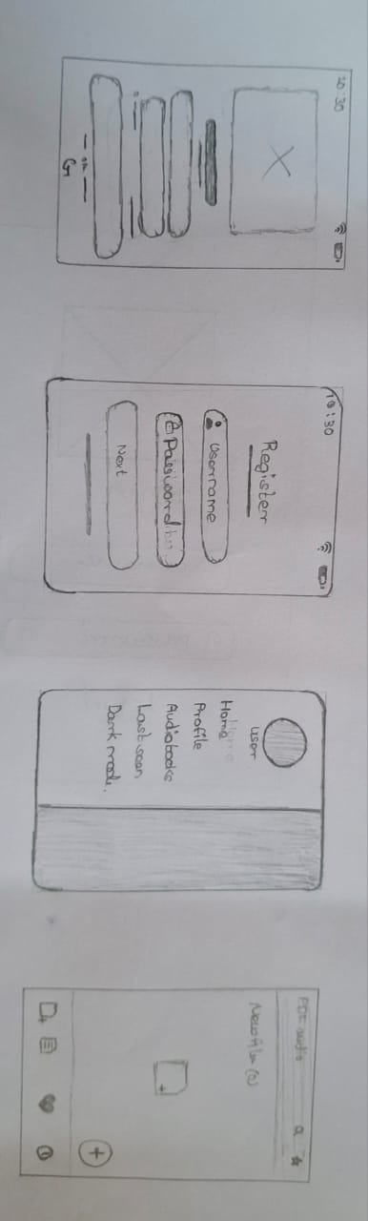
Paper Wireframes

Slide 17
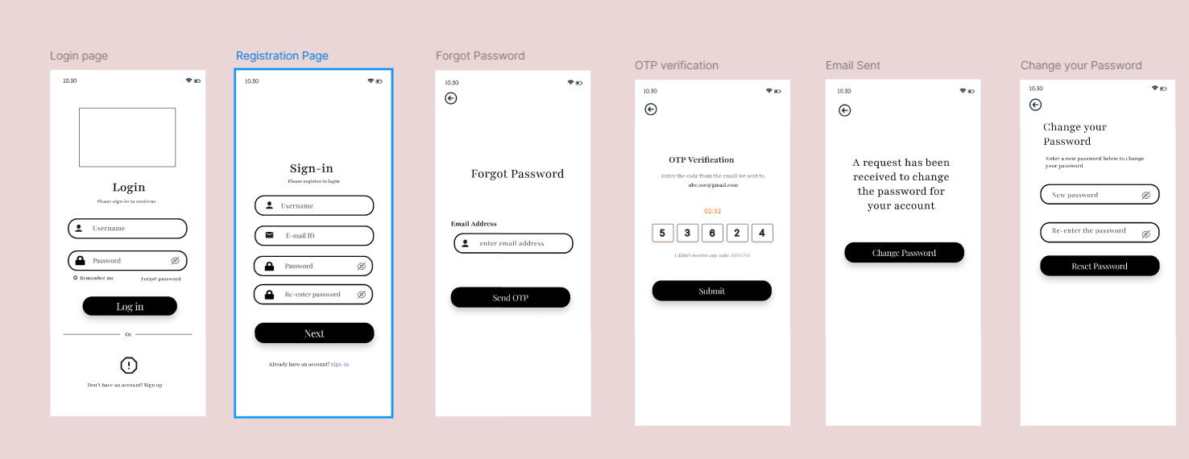
Digital Wireframes

Slide 18
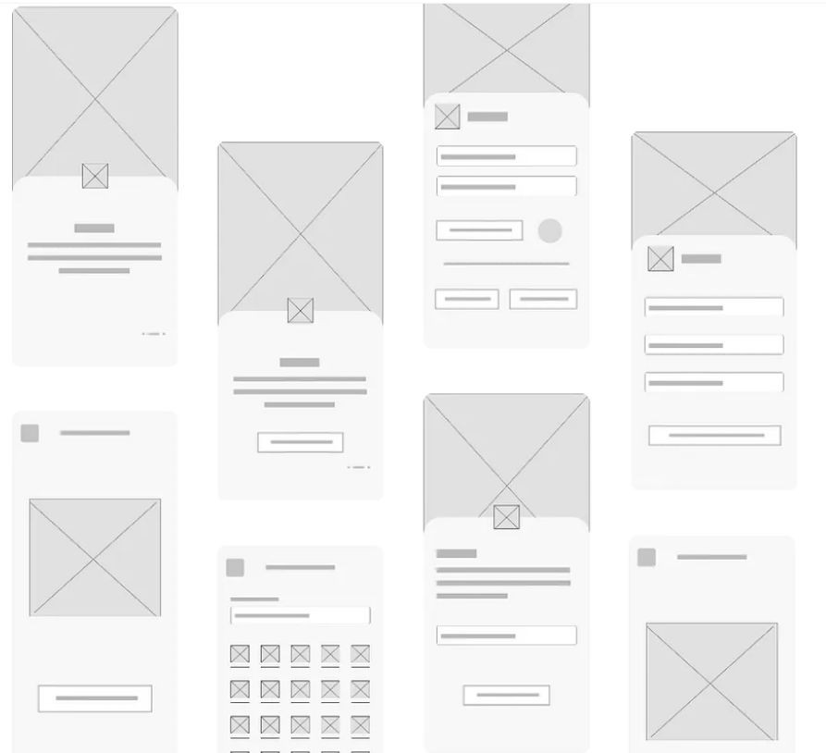
Low-ﬁdelity prototype
Here is a set of low-fidelity paper-style wireframes for your PDF to MP3 App. The design focuses on key functionalities like PDF to MP3 conversion, settings, and history tracking, arranged with a minimal and schematic approach.

Slide 19
Usability study: ﬁndings
The users were very diverse in their demands, which made creating a contained solution difficult. Some users had difficulty in connecting to new applications as making new habits was challenging. The need to make themselves socially relevant was an important goal for most of the.
Round 1 ﬁndings Round 2 ﬁndings
Users wanted better user ﬂow
Users wanted more sound interactions
Users wanted more familiarity in the features provided
Users wanted a low-tech
product
Users had difﬁculty if given a lot of choices
Users took time to get used
to the app features

Slide 20
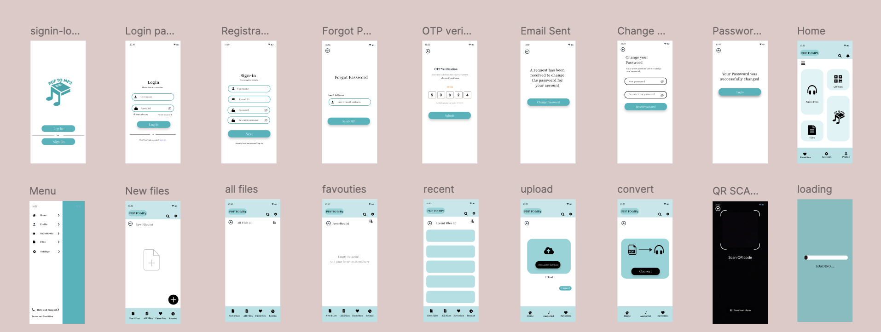
Responsive Designs
Figma

Slide 21
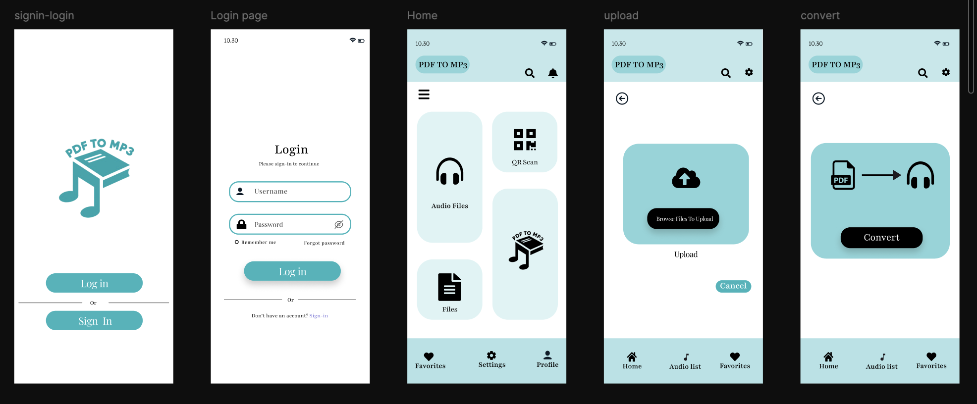
High-ﬁdelity prototype

Slide 22
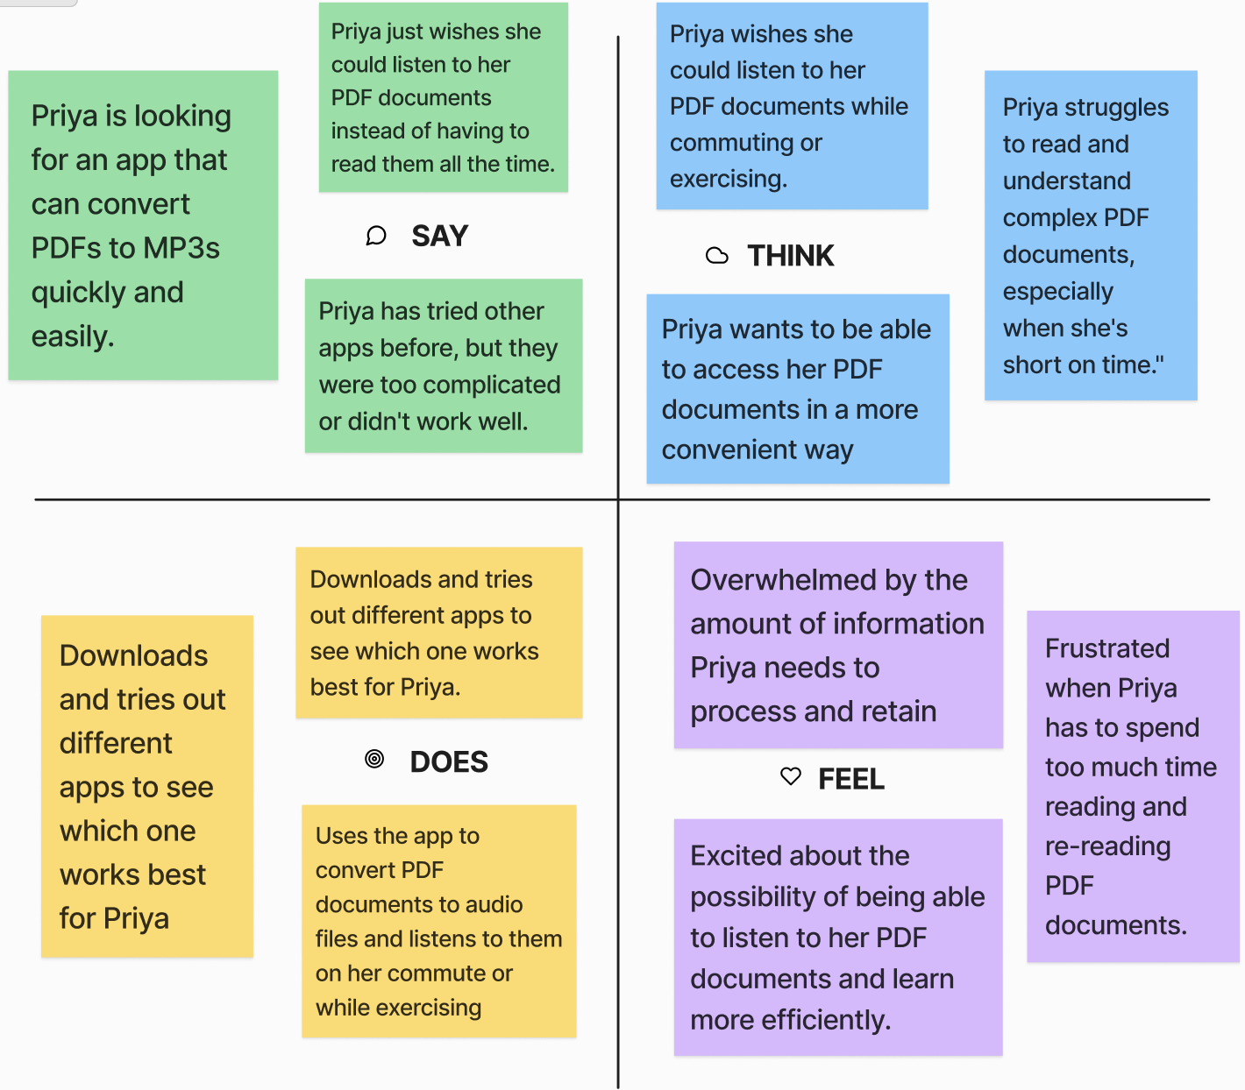
Empathy map
An empathy map is a visual tool used to gain a deeper understanding of a person's thoughts, feelings, and behaviors. It is a diagram that represents the user's perspective, helping designers, researchers, and product developers to better understand their needs, pain points, and motivations.

Slide 23
Accessibility considerations
01
02
03
Using clear icons and simple language, guided by WCAG standards, enhanced the usability of the app for users with cognitive disabilities and those new to assistive technologies.
Implemented adjustable font sizes and contrasting colors to ensure readability, making it easier for users with visual impairments to navigate the app effortlessly
Added Text-to-speech functionality and keyboard shortcuts, improving accessibility for users with motor disabilities and providing a seamless hands-free experience.

Slide 24
Product Design Patent
The PDF to MP3 App is a revolutionary tool that simplifies the process of converting PDF documents into high-quality MP3 audio files. This innovative app offers a user-friendly interface, ensuring seamless conversion for users of all technical skill levels. The app utilizes advanced algorithms to extract text from PDFs and synthesize it into natural-sounding audio, preserving the original content and formatting. With its ability to adjust playback speed, add bookmarks, and generate multiple audio tracks from a single PDF, the PDF to MP3 app caters to diverse needs, whether for students, professionals, or anyone looking for a convenient way to access information on the go. This combination of advanced technology, user-friendly design, and versatility makes the PDF to MP3 App an indispensable tool for anyone seeking to convert their digital documents into audio format.
Patent Document

Slide 25
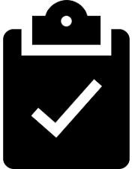
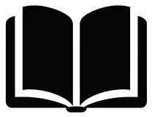
Takeaways
Impact
What I learned:
The PDF to MP3 App transforms accessibility by enabling users to convert documents into audio files. It empowers individuals with visual impairments or reading difficulties, providing them with an inclusive way to consume information. By prioritizing user-friendly designs, the app bridges gaps in accessibility, offering an essential tool for students, professionals, and elderly users alike. Its focus on inclusivity could inspire other apps to adopt similar innovations.
Developing the PDF to MP3 App emphasized the importance of user feedback and iterative design. Understanding diverse user needs led to features like multilingual support and customized playback controls, ensuring the app is both practical and inclusive. The experience highlighted how thoughtful design can significantly enhance the lives of users with varying abilities.

Slide 26
Next Steps
01
02
03
Identify the target audience and their needs for a PDF to MP3 converter.Research existing PDF to MP3 conversion tools in the market.Analyze their strengths and weaknesses to understand their features, pricing, and user experience.Identify opportunities to differentiate the app based on the market analysis.
Design a user-friendly interface that allows users to easily upload PDF files and convert them to MP3.Choose a robust conversion engine that ensures high-quality audio output.Consider features like audio format selection, audio quality control, and batch conversion for a seamless experience.
Create a compelling marketing strategy to reach the target audience.Utilize online platforms like social media, content marketing, and search engine optimization to promote the app.Partner with relevant websites and blogs for reviews and promotions.Offer free trials or promotional discounts to attract users.

Slide 27
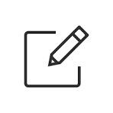
Let’s Connect
Thank you for your time to review my work for PDF TO MP3 APP. If you would like to keep in touch please contact me in the address given below
Email : agathiyanv1126.sse@saveethal.com

Slide 28
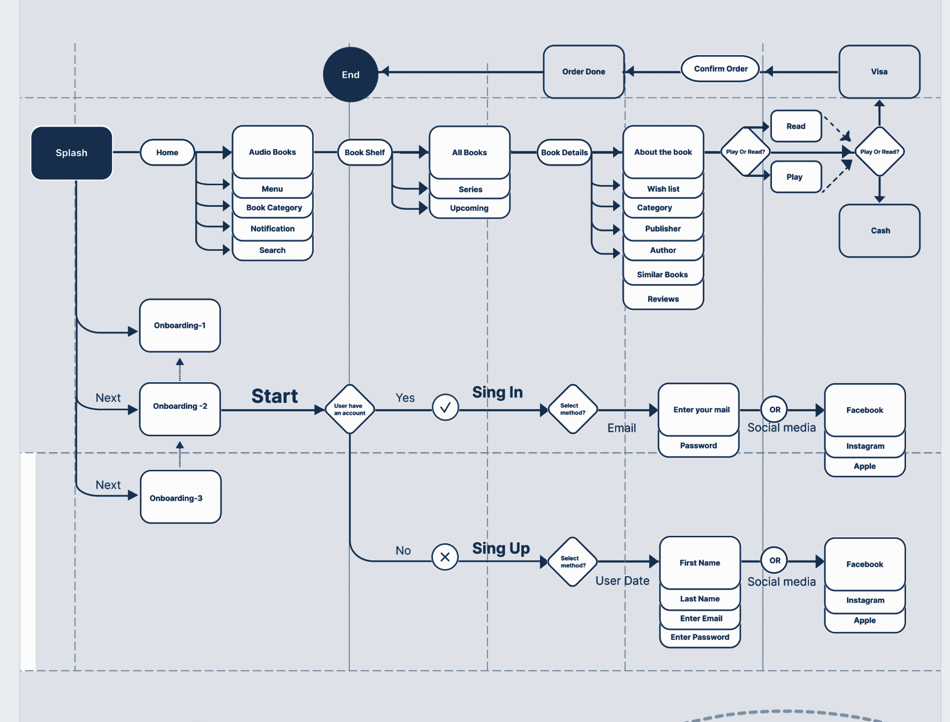
User Flow
Audio files

Slide 29
Conclusion
Simple and Secure: Easy-to-use app that safely converts PDFs to MP3 audio files.
Clear, Natural Speech: High-quality, easy-to-understand voice for listening to your documents.
Convenient for On-the-Go: Perfect for users who need hands-free access to content.
Accessibility: Ideal for those who prefer audio over reading or have visual impairments.
Efficient and Time-Saving: Lets you multitask while listening to important documents.

